Slide 1
Does The Number of College Applications Affect U.S Tuition?
Wei Chen
Jie Gao
Yijun Linghu

Slide 2
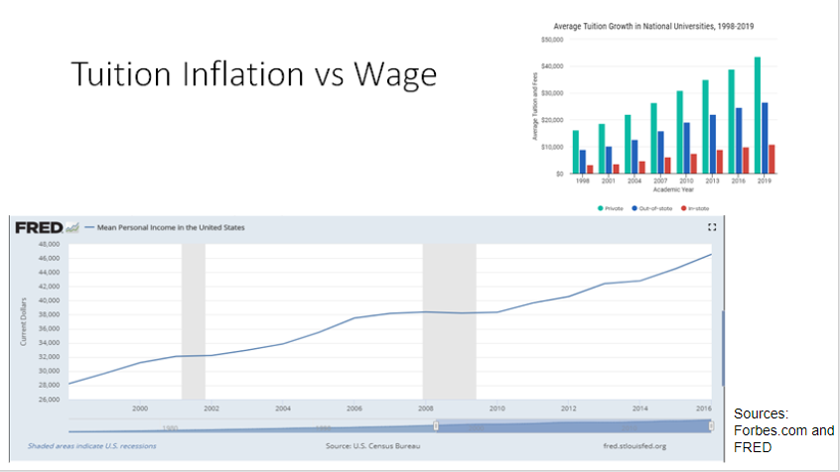
Average cost of college tuition is 2.5 times of what it was 20 years ago. By comparison, the average income today is roughly 1.7 times of what it was 20 years ago.
Average cost of college tuition is 2.5 times of what it was 20 years ago. By comparison, the average income today is roughly 1.7 times of what it was 20 years ago

Slide 3
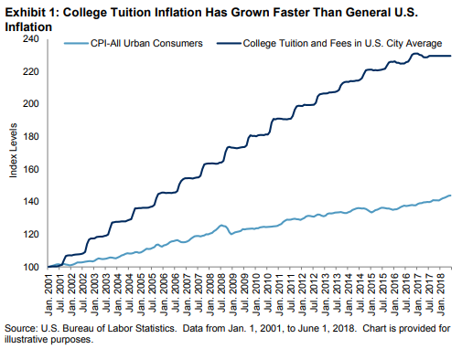
Tuition Inflation vs. General Inflation
Source: https://seekingalpha.com/article/4199086-getting-smarter-saving-college-part-1

Slide 4
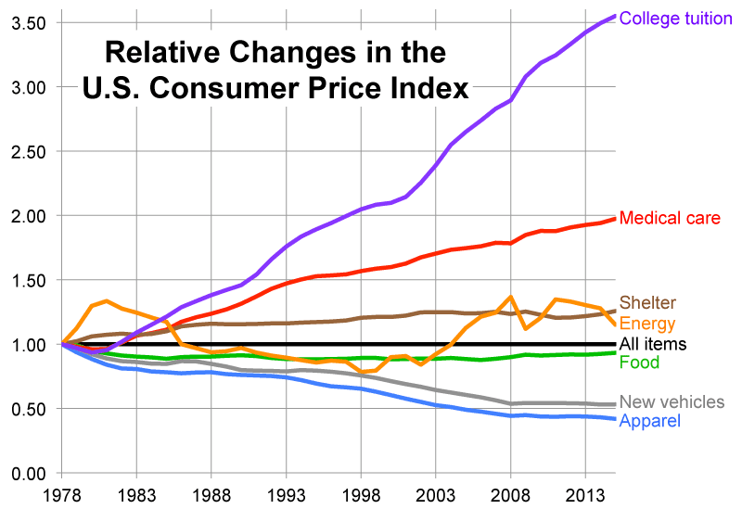
Tuition vs. other necessity expenditures
Source: http://dvschroeder.blogspot.com/2015/08/why-cost-of-college-has-tripled.html

Slide 5
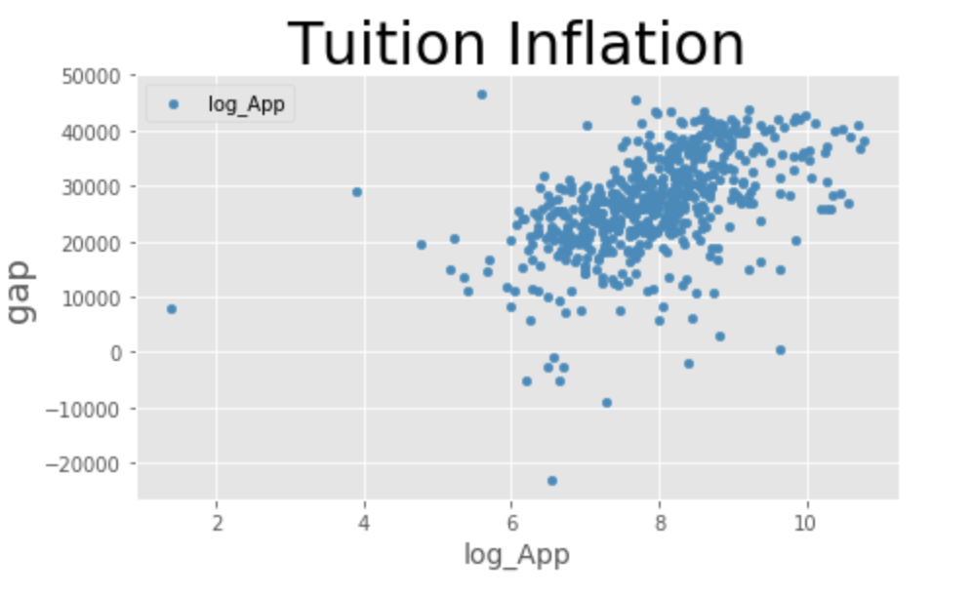
Gap: tuition - expenses/number of students

Slide 6
Literature Review
https://thescholarshipsystem.com/blog-for-students-families/the-real-reasons-why-college-tuition-is-so-high-and-what-you-can-do-about-it/
“The Real Reason Why College Tuition is so High”, Author found a relationship between high tuition tag price and amount of financial aid received and concluded that universities “know financial aid can cover the difference”.
In a separate book written by David Feldman “Why Does College Cost So Much?”, he concluded that “ a college’s sticker price is set by their wealthiest student’s ability to pay”.
New York Times Magazine writer Adam Davidson suggests “high tuition allows colleges to shape their student bodies”.
If application quantity is a factor of tuition, then all these conclusions are correct!

Slide 7
Purposes
Identify a driving force that contributes to the price of our second largest investment for the purpose of more price-efficient investment selection.
Clarify cost structure of education to make the market of education more efficient and transparent.
Information symmetry regarding educational cost will render the prices of education more accurately reflect its qualities.
Explore remedies that the education system can make so that student debt does not consume our financial future.

Slide 8
Hypotheses
The market treats education as a commodity, tuition as price, number of applications as quantity demanded.
The amount of applications received has a positive effect on college tuition just as high demand of any commodity causes commodity price to increase.
Universities, like other businesses, will seize the opportunity to increase tuition through methods that do not contribute directly to education quality.

Slide 9
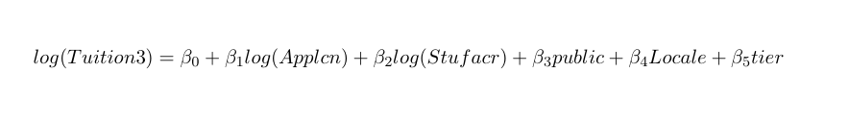
Model Description -- Ordinary Least Squares
Tuition3: Out-of-state average tuition for full-time undergraduates
Applcn: Applicants total
Stufacr: Student-to-faculty ratio
Public: 1 if public or private not-for-profit, 0 otherwise
Locale: Degree of urbanization
Tier: Selectivity and type combination

Slide 10
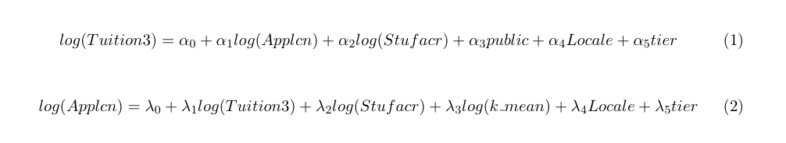
Model Description --
Simultaneous Equations Model (SEM)
Tuition3: Out-of-state average tuition for full-time undergraduates
Applcn: Applicants total
Stufacr: Student-to-faculty ratio
Public: 1 if public or private not-for-profit, 0 otherwise
Locale: Degree of urbanization
Tier: Selectivity and type combination
K_mean: Individual labor earnings (sum of wage and self-employment earnings)

Slide 11
Data Description
Datasets Sources:
“The Integrated Postsecondary Education Data System”(IPEDS)
“Mobility Report Cards: The Role of Colleges in Intergenerational Mobility”(k_mean, tier)
Sample size:
originally 2248 from the first source, 758 left after merge, 750 left after excluding missing values
Cross-section data in 2013

Slide 12
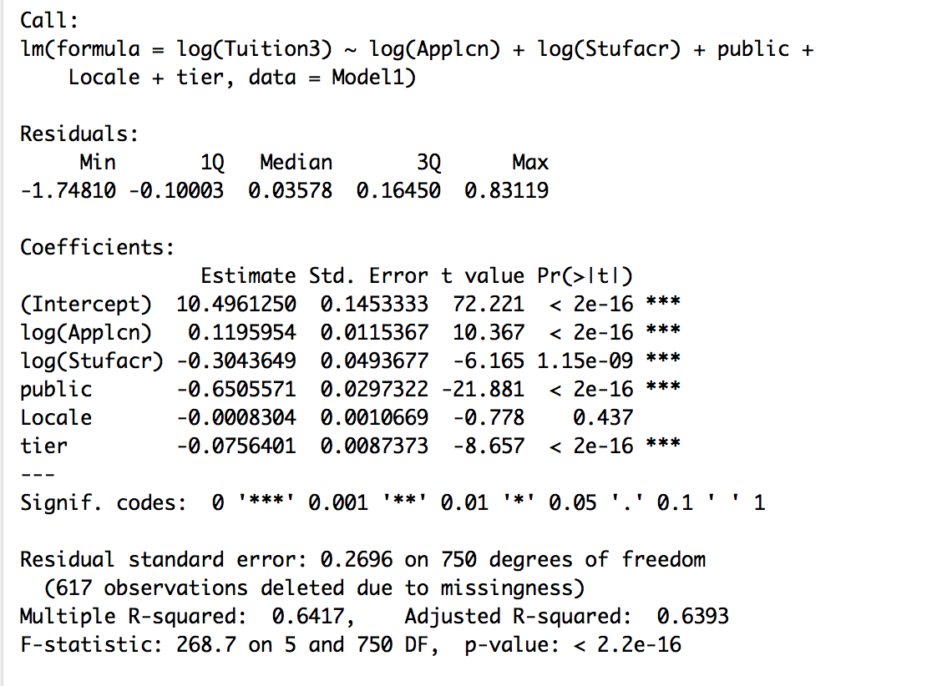
Results--OLS

Slide 13
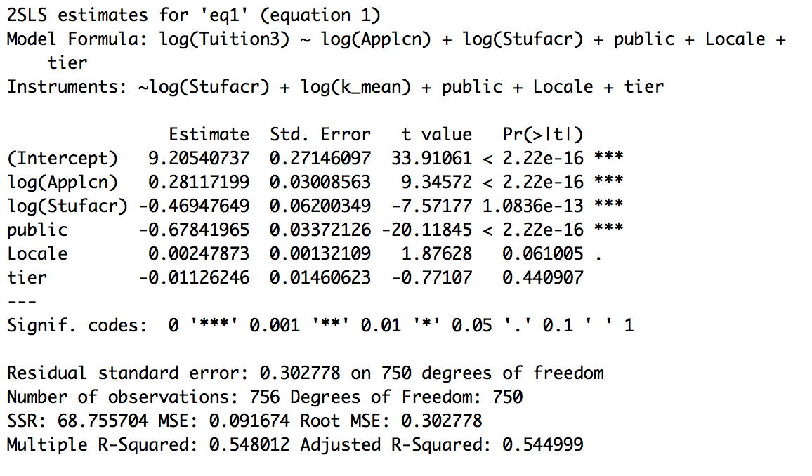
Results--SEM (Eq1)

Slide 14
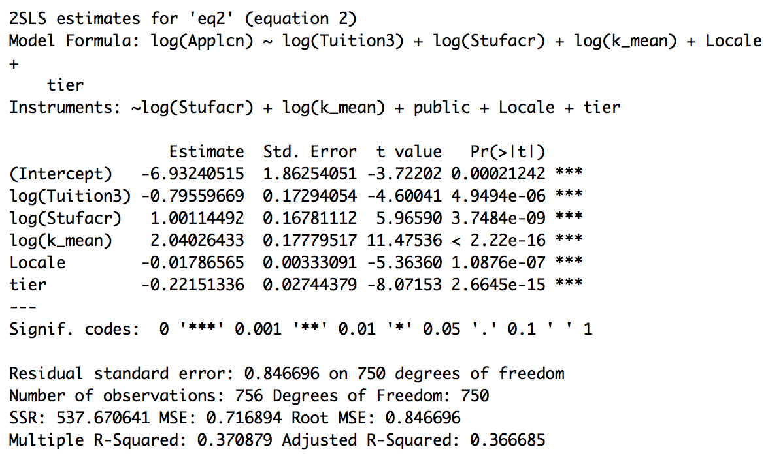
Results--SEM (Eq2)

Slide 15
Findings
~3.5% increase in application numbers -> 1% increase in tuition costs
SEM predicts more accurately than OLS
Tier and future income do not influence tuition fee directly, instead through application mechanism

Slide 16
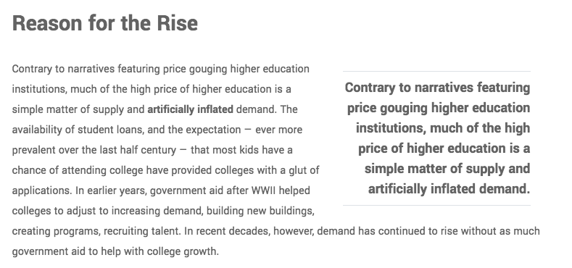
Source: https://www.bestvalueschools.com/understanding-the-rising-costs-of-higher-education/

Slide 17
Implications for Education System
Applicants should not be deluded by college’s popularity, or absolute rank.
Colleges should publish detailed tuition costs breakdown, and predict overall expenses on a four-year basis.
Subsidize more to those colleges that have smaller values of “gap” (less popular ones).

Slide 18
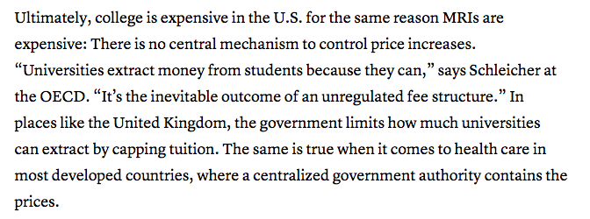
Source: https://www.theatlantic.com/education/archive/2018/09/why-is-college-so-expensive-in-america/569884/

Slide 19
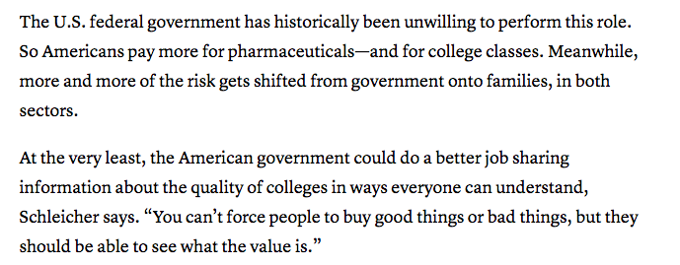

Slide 20
Limitations
We gathered 1-year data only. Did not predict tuitions increase over time as a function of application number increase.
High volume of applications may result in a more intricate/costly selection process, however slightly.
We studied the effect of application quantity alone, so the result is unlikely to persuade students of their choices in college selection. Must include other factors.

Slide 21
Possible Extensions
Other than application numbers, research of similar fashion can extend to:
Non-academic faculty/student ratio (administrative costs)
Number of programs offered
Advertisement costs (for-profit universities)

Slide 22
Thank You!

